Slide 1
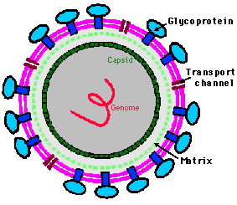
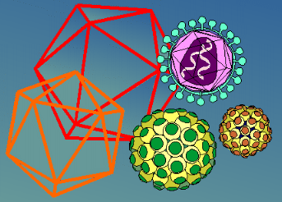
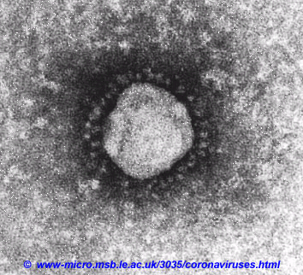
Scientific Practice IIA: An introduction to the world of viruses
Professor M E C Rey
School of Molecular and Cell Biology

Slide 2
OUTLINE OF COURSE
Introduction to Viruses
Structure of Viruses
Virus Taxonomy and Classification
Working with viruses in the laboratory
Life cycles of viruses; replication and transcription
Bacteriophages
Viruses and Diseases
Emerging viruses
Influenza
Human Immunodeficiency virus (HIV)
Zika virus
Bat viruses

Slide 3
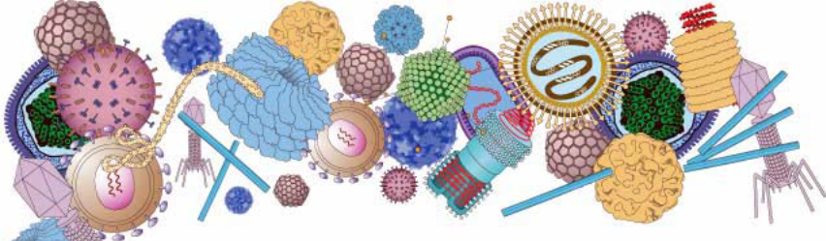
STRUCTURE AND TAXONOMY OF VIRUSES

Slide 4
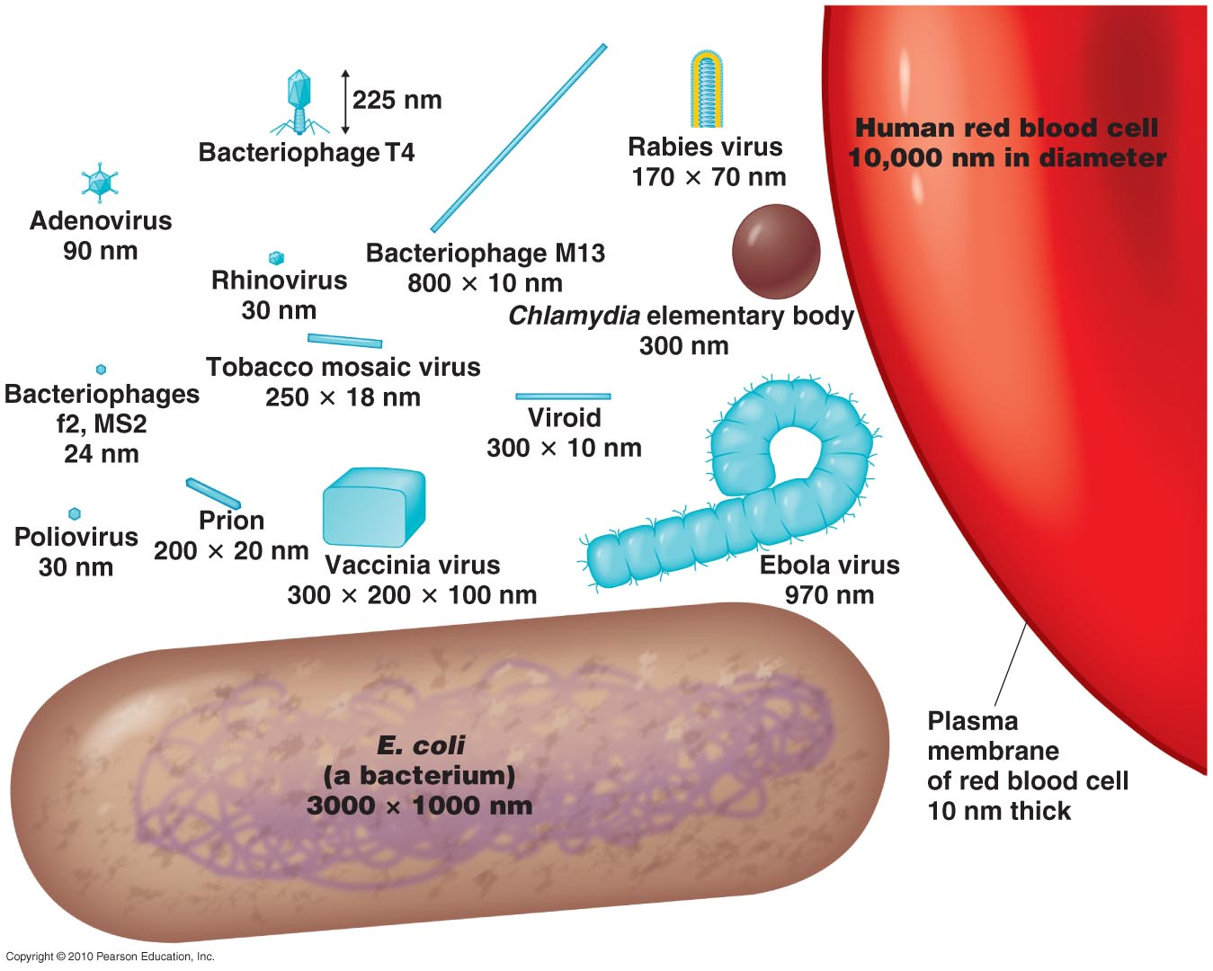
Virus Sizes
Figure 13.1

Slide 5
General Characteristics of Viruses
Obligatory intracellular parasites
Contain DNA or RNA
Surrounded by a protein coat (capsid)
Some are enclosed by an envelope
Some viruses have spikes sticking out from envelope
Most (not all) viruses infect only specific types of cells in one host
Host range is determined by specific host attachment sites and cellular factors

Slide 6
STRUCTURE AND SHAPES
Two main classes of virus structures: helical and icosahedral (isometric) symmetry
To form infectious particles viruses must assemble using information from the components and form regular geometric shapes even though capsid proteins are irregular in shape
How? By using the rules of symmetry.
Virus capsids are made up of multiple protein subunits or capsomer subunits which assemble through electrostatic and hydrophobic interactions
Subunits can be made up of several smaller identical or non-identical polypeptides
Subunits are arranged helically around the helical nucleic acid in helical viruses
In isometric viruses the subunits are arranged around the vertices or faces of a cubic symmetrical structure such as an icosahedron which is made up of 20 equilateral triangles

Slide 7
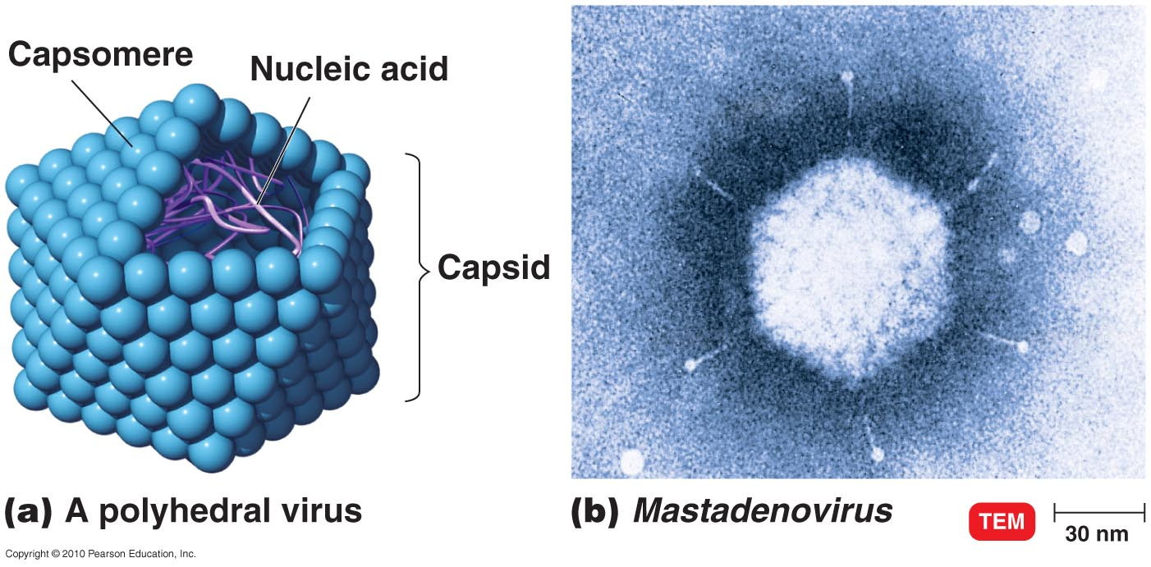

Morphology of a Polyhedral (icosahedral) Virus
Figure 13.2

Slide 8
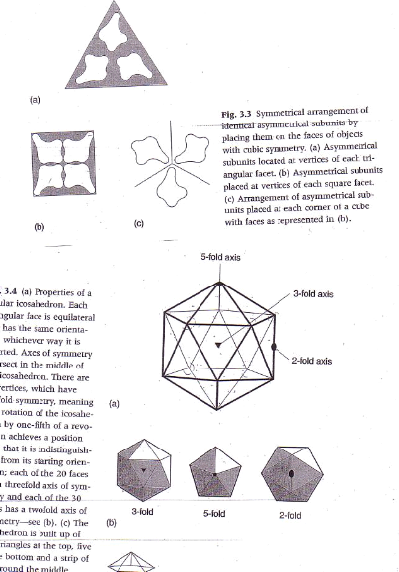
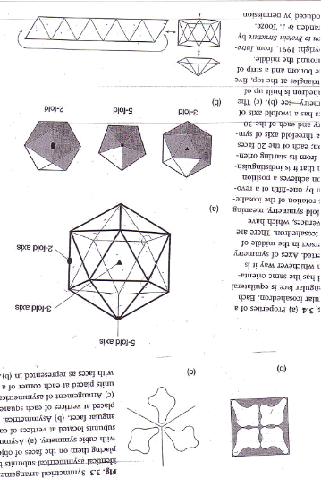
Icosahedron
A triangular face can only have 3 protein subunits in symmetry. The simplest isometric virus is the icosahedron: has 20 triangles with 3 subunits/triangle = 60 subunits (fig. 3.3)
Icosahedron has 5 triangles on top and 5 at the bottom and ten in the middle (fig.3.4)
Icosahedron has 12 vertices and three axes of symmetry: fivefold, threefold and twofold. Axes of symmetry meet in the middle of the icosahedron (fig. 3.5).
Subunits can vary in size depending on size of virus
Larger viruses are domes or spheres with their surfaces divided into triangular facets
vertice
Fig.3.3
face
Fig. 3.5
Fig. 3.4

Slide 9
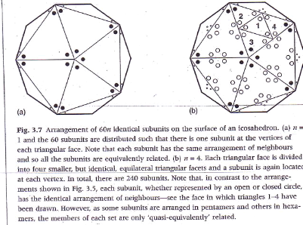
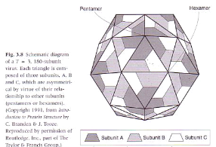
What happens when a 60 SU icosahedron needs to increase its size to fit larger NA?
We need to arrange more identical subunits so how do we do this?
Subdivide the surface of a sphere into triangular facets which are arranged with icosahedral symmetry (which gives a minimum-energy structure); larger the virus NA the larger the circle, more triangles can be added or the subunit proteins are larger
Each triangular face is divided into 4 smaller but identical, equilateral triangular facets (Fig. 3.7b), giving 240 subunits (n=4; 60x4)
Note that at the vertices of the orginal icosahedron there are rings of 5 subunits called pentamers, but at the other vertices there are 6 subunits called hexamers
The original icosahedron face can also be divided into 3 equilateral triangles and each new triangular facet can be further triangulated following laws of geometry(Triangulation number T= Pf² where f= the number of smaller identical equilateral triangles (1,2,3,4 etc. and P=1, 3 or 7)
The smallest virus is T=1 (P, f are 1) with 60T (60 X1) subunits. T=3 means P=3 and f=1 which has 3 x 60 = 180 subunits (fig. 3.8)

Slide 10
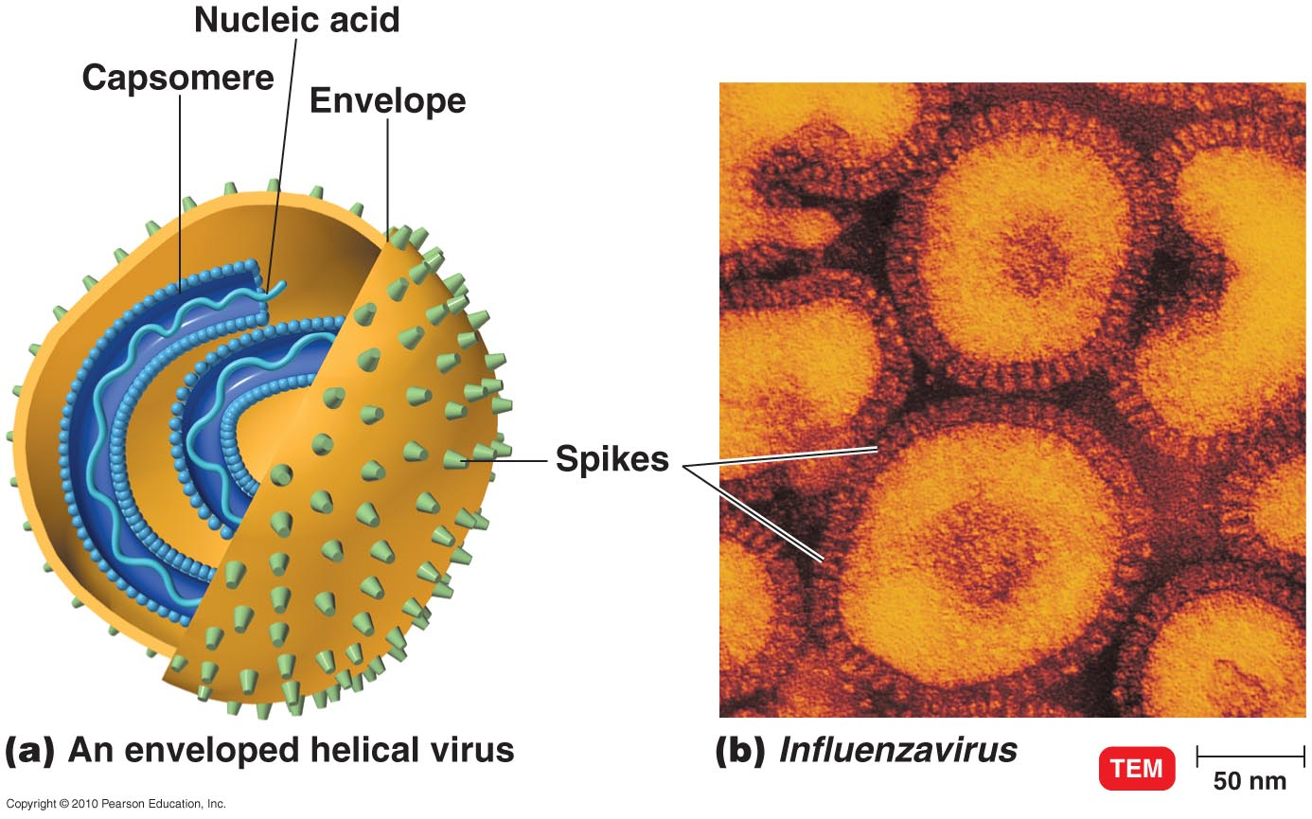
Morphology of an Enveloped Virus
Figure 13.3

Slide 11
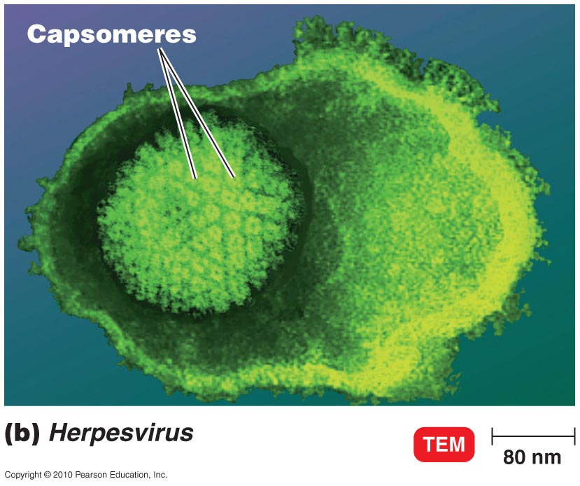
Enveloped Viruses
Figure 13.16b

Slide 12
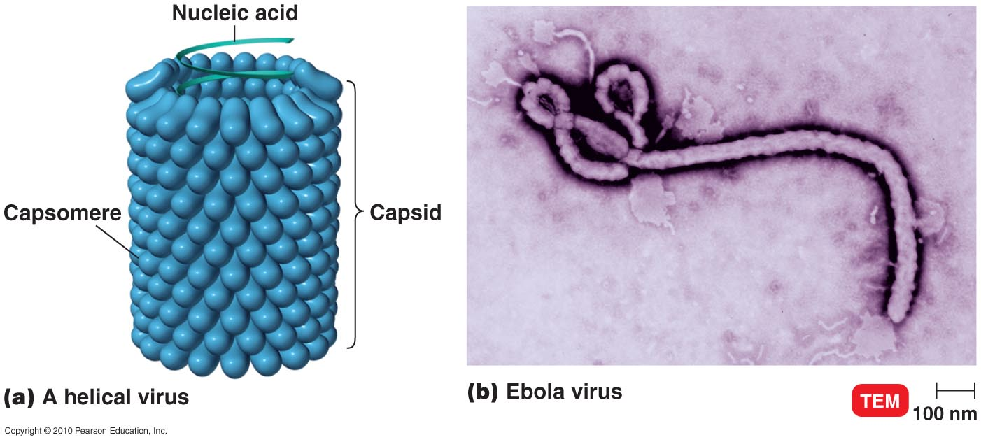
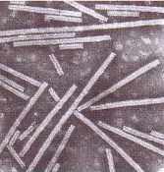
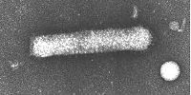
Morphology of a Helical Virus

Slide 13
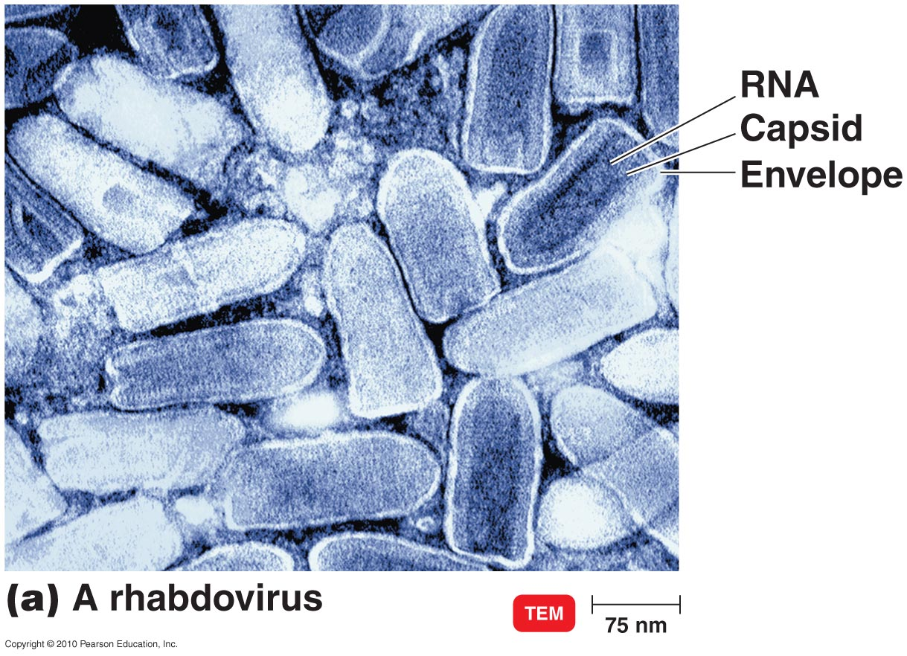
Rhabdoviridae
Single-stranded RNA, – strand, one RNA strand
  Vesiculovirus
  Lyssavirus (rabies virus)
  Cause numerous animal diseases
Figure 13.18a

Slide 14
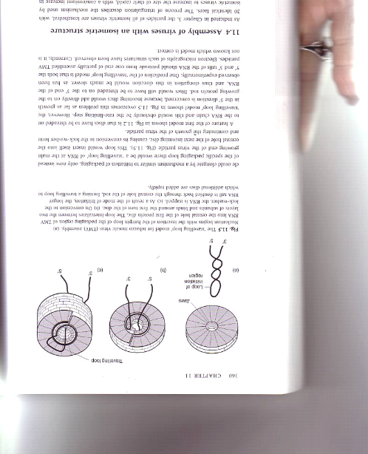
Assembly of a helical virus

Slide 15
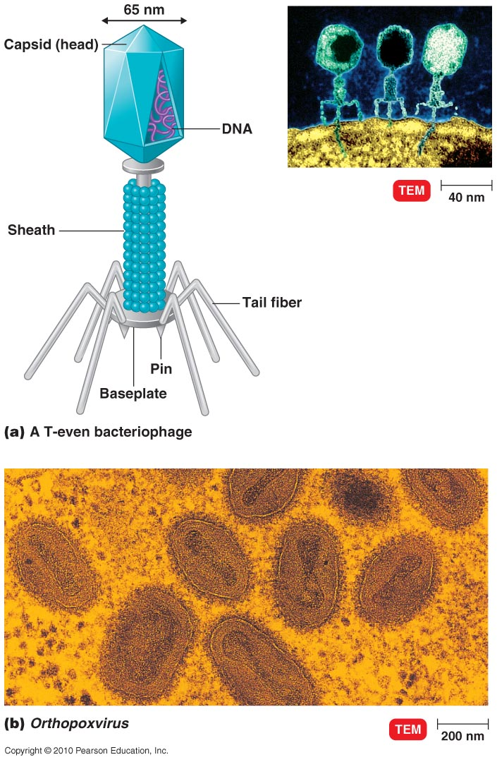
Morphology of a Complex Virus
Figure 13.5

Slide 16
Taxonomy of Viruses
Family names end in -viridae.
Genus names end in -virus.
Viral species: A group of viruses sharing the same genetic information and ecological niche (host). Common names are used for species.
Subspecies are designated by a number.

Slide 17
Taxonomy of Viruses
Herpesviridae
Herpesvirus
Human herpes virus HHV-1, HHV-2, HHV-3
Retroviridae
Lentivirus
Human immunodeficiency virus HIV-1, HIV-2

Slide 18
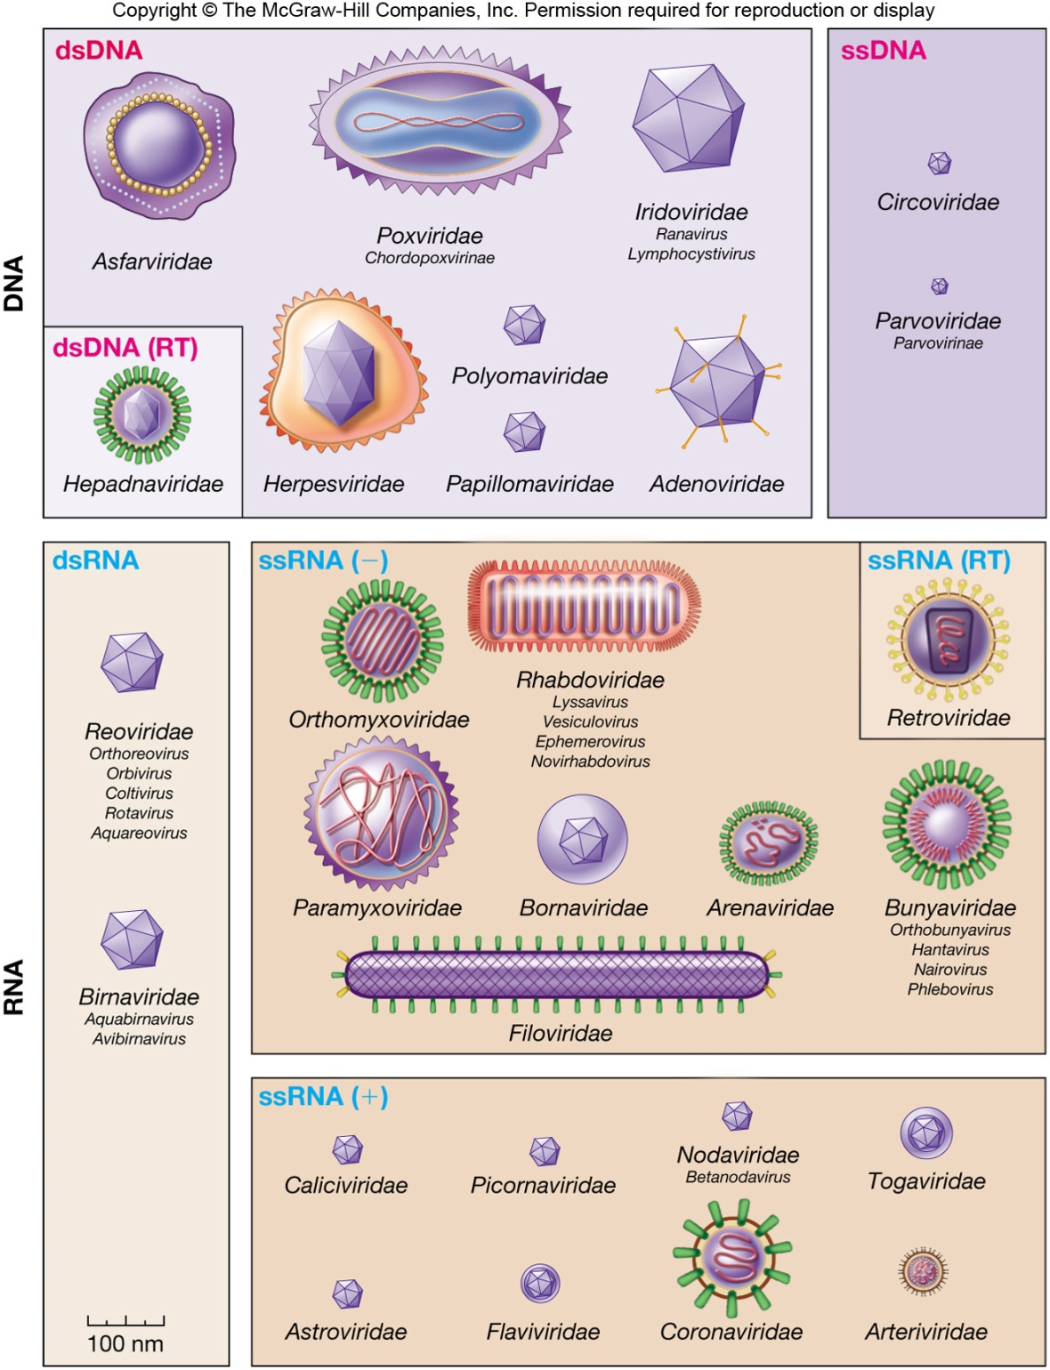
Figure 25.2b

Slide 19
Basic Classification Scheme
The problem with Virus Classification:
Viruses are not directly related by evolutionary descent
Probably have multiple origins; co-evolution with host
no universal feature (e.g. rRNA)
Viruses are classified by:
The type of nucleic acid they possess (see figure);
Shape; enveloped or not;
Host;
How they achieve transcription;
The Baltimore Classification Scheme
All viruses need to produce mRNA. David Baltimore developed a scheme to classify viruses using this criterion.
Are 7 groups: ssDNA; dsDNA; dsRNA; + sense ssRNA; -ve sense RNA; ss RNA reverse transcribing virus with DNA intermediate; dsDNA with RNA intermediate

Slide 20
The Baltimore Classification Scheme
− DNA
+/- DNA
+ DNA
retroviruses
mRNA
+ RNA
Sub-genomic RNAs (-RNA)
Protein
− RNA
+/- RNA
Direct protein translation and cleavage into smaller polypeptides
Notes:
NB Handout pp 61, 62 Basic Virology

Slide 21
KEYPOINTS
Viruses are composed of protein, nucleic acids and sometimes lipid envelopes
There are two basic symmetries, helical and icosahedral (polyhedral)
Virus capsids are made up of protein subunits or capsomeres which fold to form specific structures
Genomes within virus capsids are linear or circular RNA or DNA which are folded and interact with the capsid proteins through electrostatic or hydrophobic interactions
Viable virus particles or virions are infectious
Viruses have multiple origins and co-evolved with hosts
Viruses are classified according to the expression (mRNA) of their genes

Slide 22
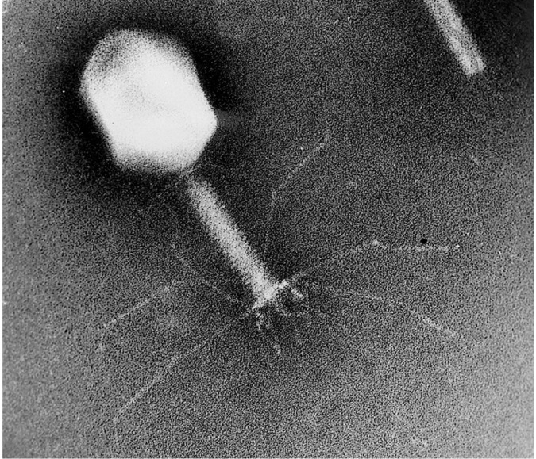
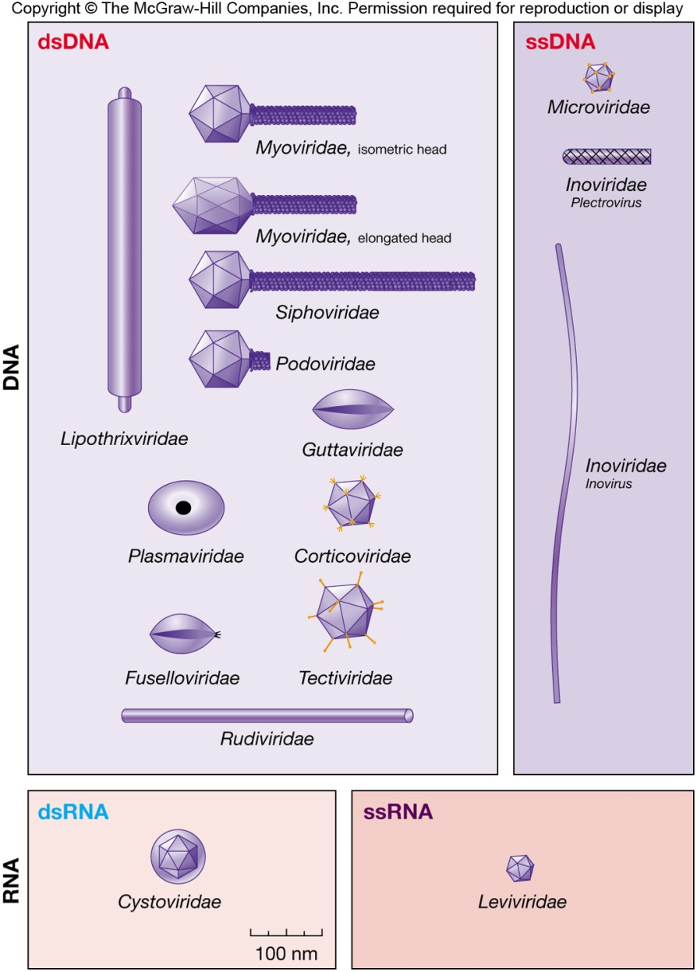
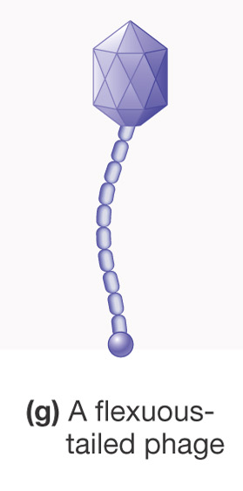
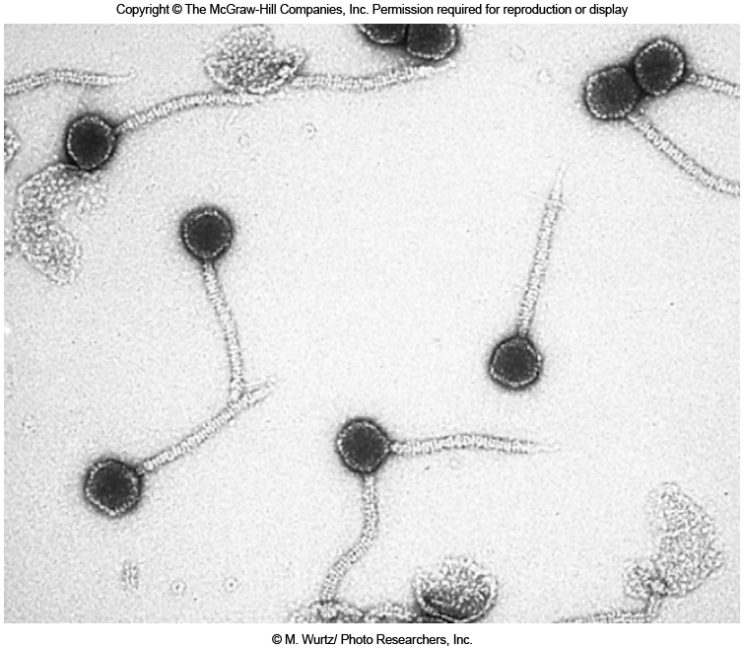
BACTERIOPHAGES

Slide 23

The Lytic Cycle
The lytic cycle is a phage replicative cycle that culminates in the death of the host cell; there is NO integration into the bacterial host genome
The lytic cycle produces new phages and lyses (breaks open) the host’s cell wall, releasing the progeny viruses and the cell dies
A phage that reproduces only by the lytic cycle is called a virulent phage
Bacteria have defenses against phages, including restriction enzymes that recognize and cut up certain phage DNA
Animation: Phage T4 Lytic Cycle
© 2011 Pearson Education, Inc.

Slide 24
The Lytic Cycle
Attachment: Phage attaches by tail fibers to host cell
Penetration: Phage lysozyme opens cell wall; tail sheath contracts to force tail core and DNA into cell
Biosynthesis: Production of phage DNA and proteins
Maturation: Assembly of phage particles
Release: Phage lysozyme breaks cell wall

Slide 25
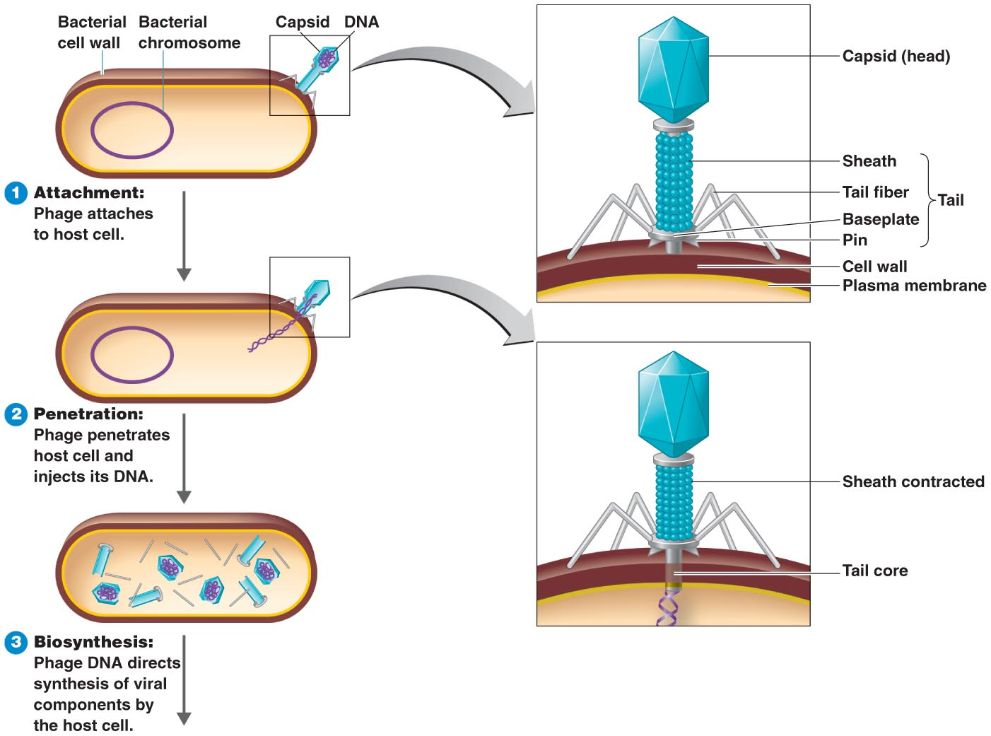
Lytic Cycle of a T-Even Bacteriophage
1
2
3
Figure 13.11

Slide 26
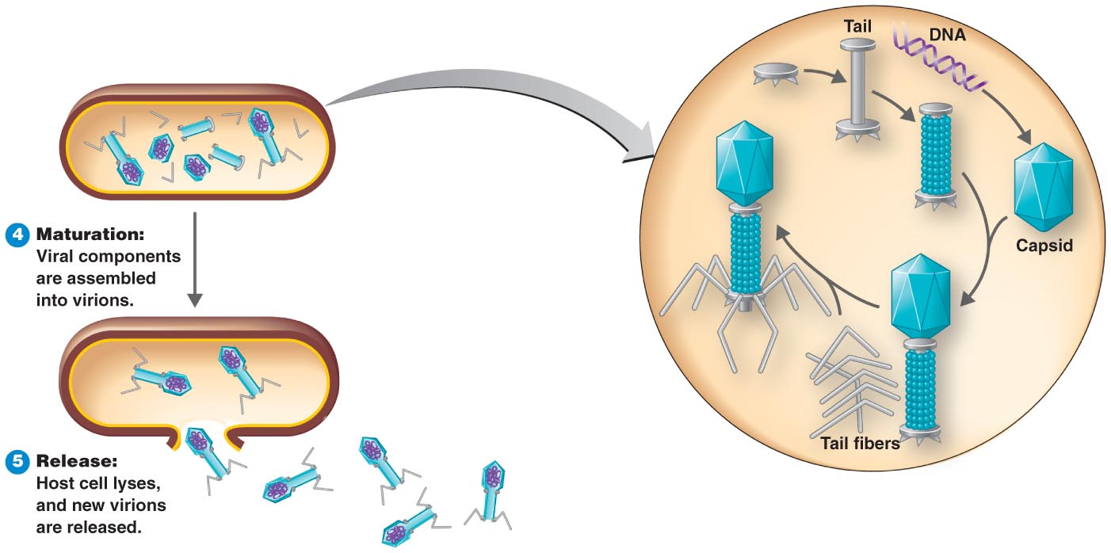
Lytic Cycle of a T-Even Bacteriophage cont.
4
Figure 13.11

Slide 27
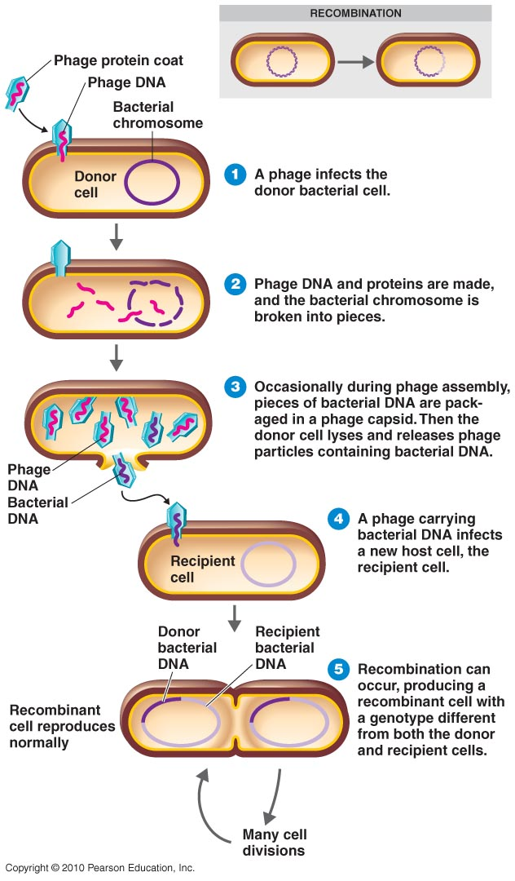
Generalized Transduction
2
3
4
5
6
Figure 8.28

Slide 28
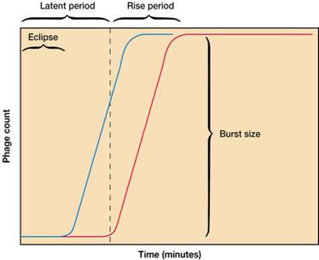
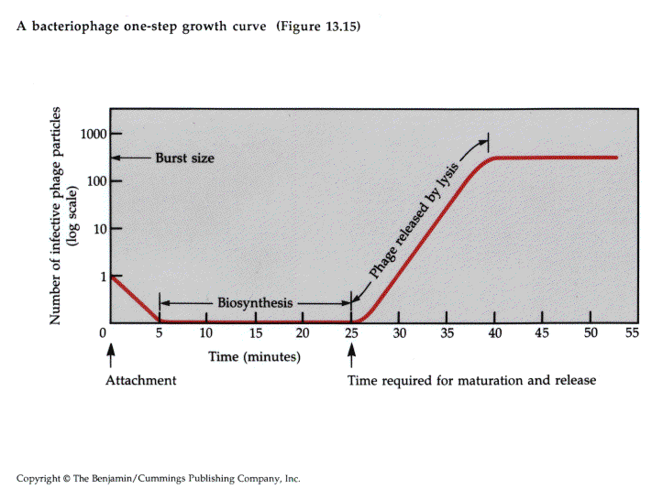
One step growth curve: burst size determination
Bacteria mixed with phage for a short time; then mixture is diluted; samples removed at specific intervals and plated to quantify phage in culture
Eclipse phase: attachment and penetration
Latent phase: no phage virions yet (biosynthesis of phage enzymes; NAs etc.)
Rise phase: increase in plaque forming units (pfu) due to lysis of bacteria. At start of experiment plaque count is relatively constant as each bacterium will yield one plaque. In lab we synchronize phage population replication by chloroform lysing at time intervals. Due to dilution of adsorption mixture released phage fail to meet susceptible bacterium and do not infect them & remain free in culture medium. This leads to the plateau and no newly infected bacteria; at intervals during latent phase no. of assembled virions should go up until lysis.
Therefore burst size (no. of phage released per bacterium) relates to the no. plaques at the plateau (one bacterium=one plaque=one phage)
Blue line: total no. of complete virions
Red line: no. free phage (unabsorbed + lysed host cells)
Note: Students to read practical manual for outline of procedure

Slide 29
The Lysogenic Cycle
The lysogenic cycle replicates the phage genome without destroying the host
The viral DNA molecule is incorporated into the host cell’s chromosome
This integrated viral DNA is known as a prophage
Every time the host divides, it copies the phage DNA and passes the copies to daughter cells
Some phages can switch to lytic cycle and can take some host DNA with it (specialized transduction)
Animation: Phage Lambda Lysogenic and Lytic Cycles
© 2011 Pearson Education, Inc.

Slide 30
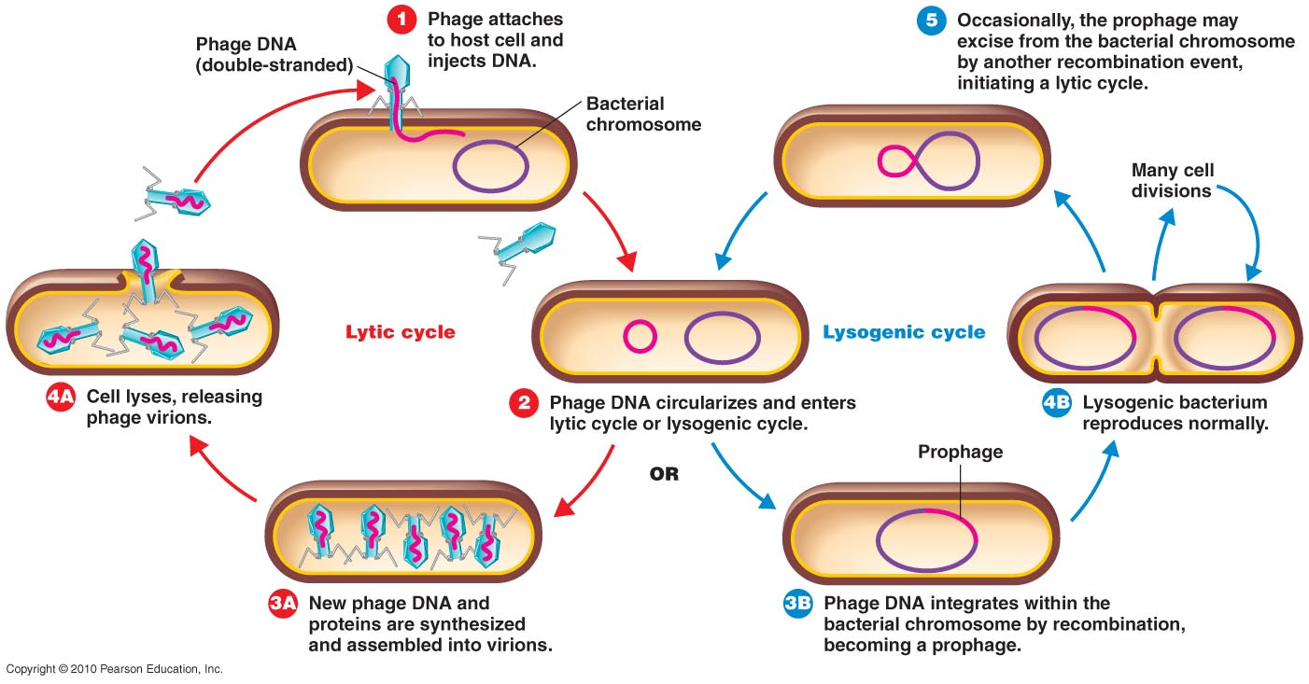
The Lysogenic Cycle

Slide 31
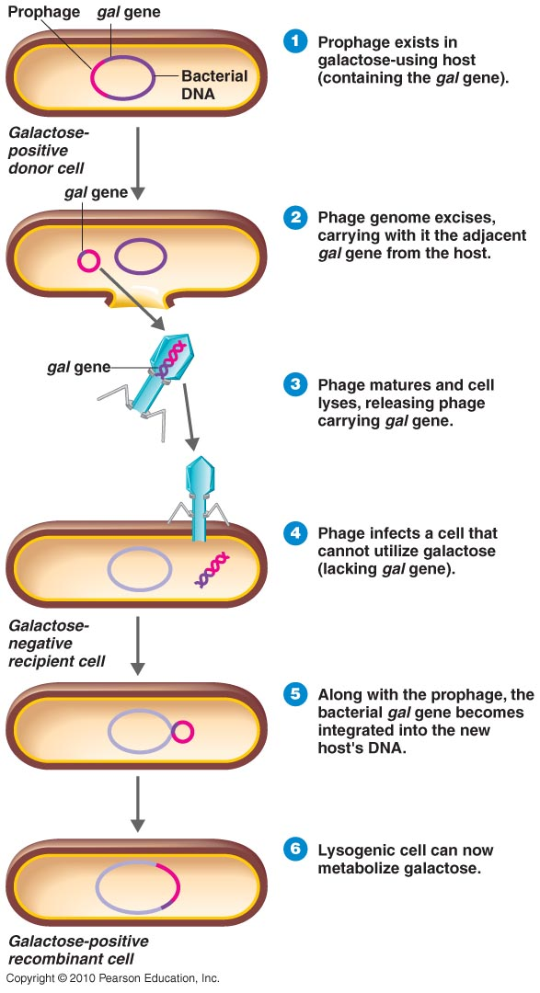
Specialized Transduction

Slide 32
WORKING WITH VIRUSES IN THE LABORATORY:
CULTIVATION, ISOLATION AND DETECTION OF VIRUSES

Slide 33
CULTURE OF VIRUSES
Began in the early 20th century with whole organ then progressed to individual cells involving primary cell cultures or immortalized dedifferentiated cell lines
Plaque assay to quantify animal or bacterophages using virus dilutions and monolayers of cultured cells
Viruses cause cytopathic effects in infected cultured cells
Some viruses e.g. HIV do not replicate in culture and do not produce plaques e.g. HIV
However investigations of natural infections is best done in natural hosts; not always possible so use experimental animals e.g. rats
Some viruses e.g. influenza is grown in embyonated eggs
Plant viruses grown in host plants or can infect protoplasts

Slide 34
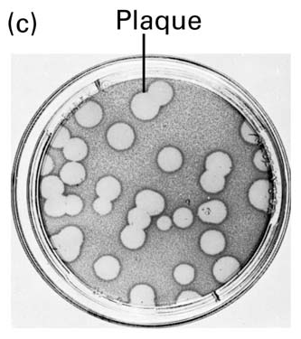
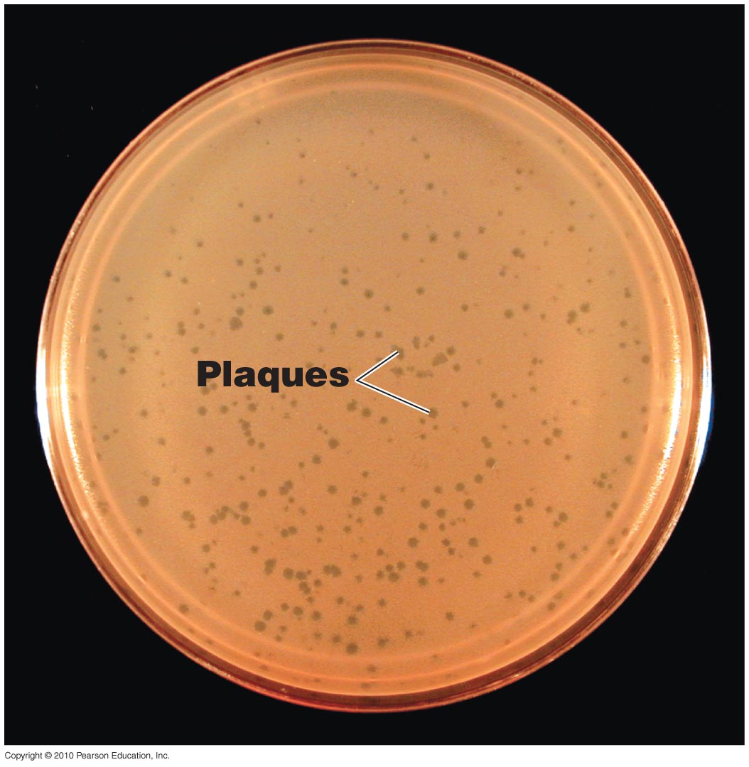
Viruses must be grown in living cells
  Plaques formed by poliovirus plated on HeLa cells (c)
  Bacteriophages form plaques on a lawn of bacteria

Slide 35
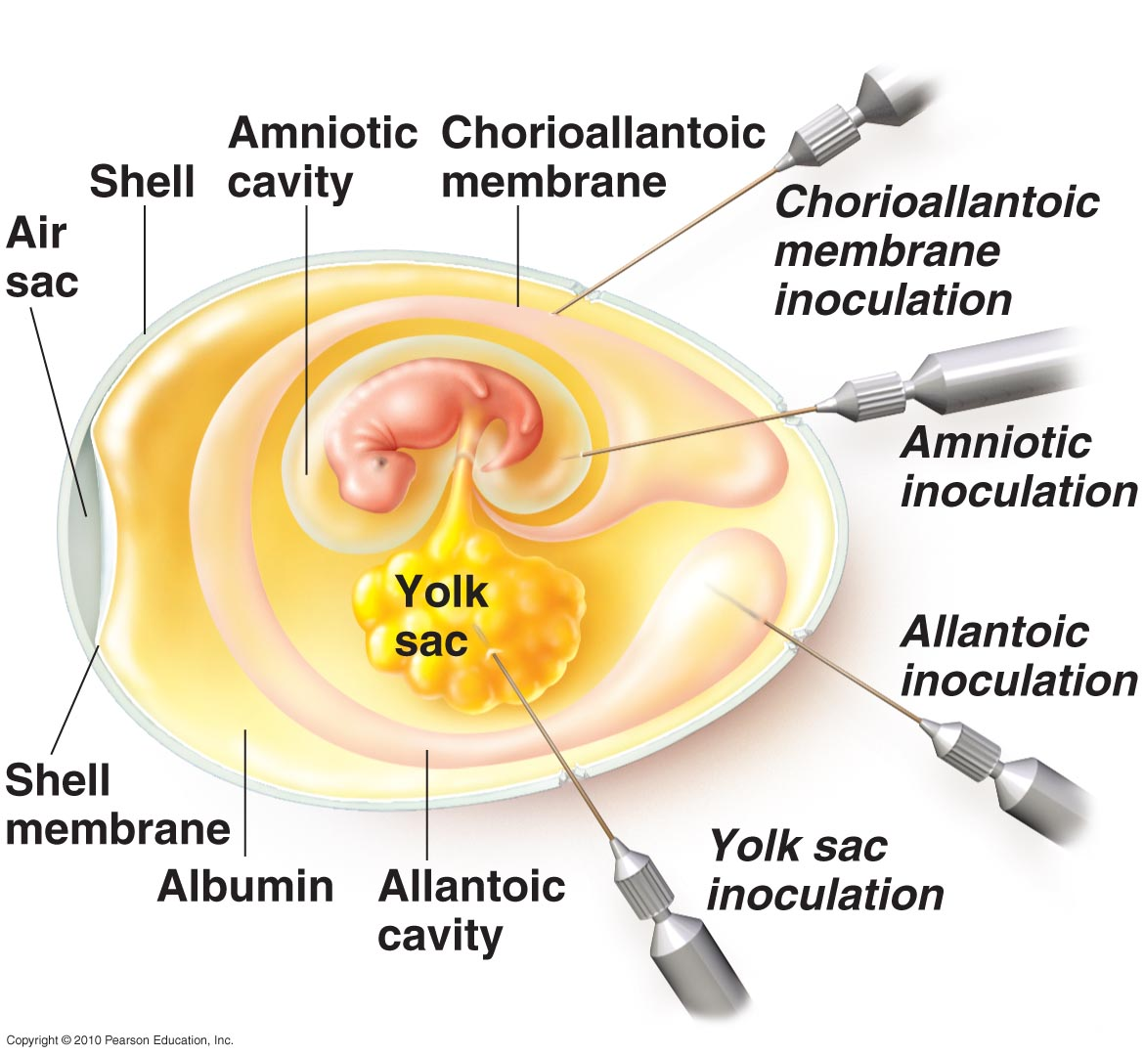
Growing Viruses
Animal viruses may be grown in living animals or in embryonated eggs

Slide 36
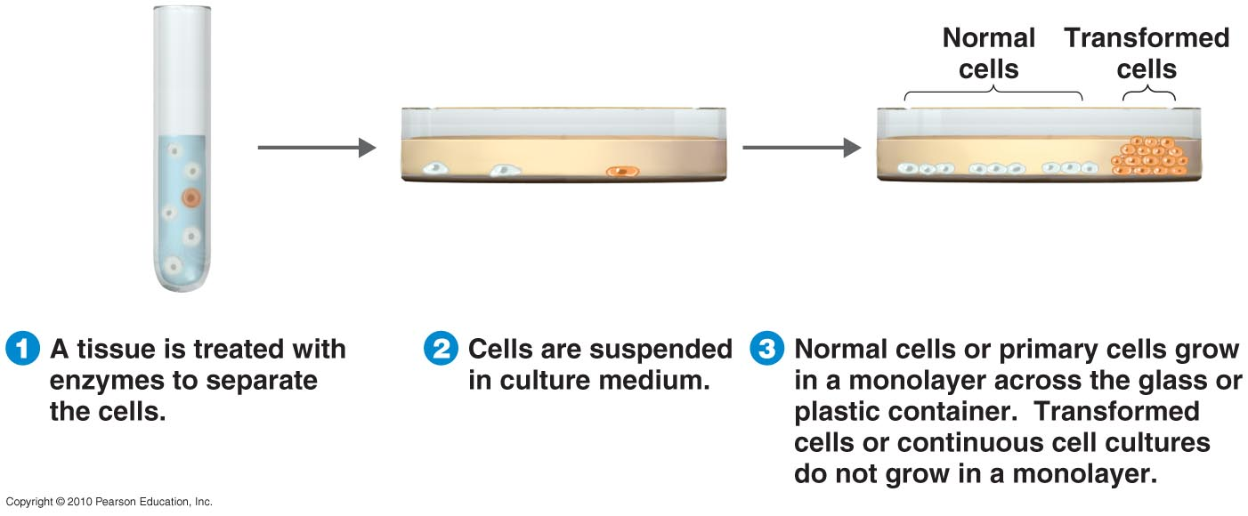
Growing Viruses
Animal and plant viruses may be grown in cell culture (cells derived from human tissue such as liver, epidermis or kidneys)
  Continuous cell lines may be maintained indefinitely

Slide 37
Isolation of viruses
Biological macromolecular material can often be separated according to it’s size, density or charge
Enveloped viruses (and other cellular organelles) can often be separated according to their buoyant density (e.g. viruses with large membranes are less dense than those with smaller envelopes). Proteins or nucleic acid will be much denser.
Separation based on density is accomplished by generating an equilibrium density gradient of, generally sucrose, in an ultracentrifugal field
The virus particles will band / float according to their respective equilibrium buoyant density

Slide 38
Rate Zonal Centrifugation
Form of differential centrifugation based on size of particles
Allows rapid fractionation and purification of subcellular particles (e.g. organelles; virions)
Largest particles will sediment most rapidly or under the least force
e.g. In an infected cell – organelles e.g. mitochondria will sediment first, then virus, then ribosome
600 g 10 min.
15,000 g 15 min.
100,000 g 15 min.
mitochondria, chloroplast, lysosomes in pellet
plasma membrane, microsomal fraction
nuclei in pellet
filtered homogenate
supernatant
300,000 g 10 min.
virus in pellet (and ribosomes)

Slide 39
Virus Identification
Cytopathic effects (microscopy)
Serological tests (proteins)
  Based on the principal of the specificity of binding of an antibody (Ab) to a specific antigen/viral antigen
  Detect antibodies against viruses, or virus-infected cells expressing virus antigens on surface, in a patient
  Or use antibodies to identify viruses in neutralization tests such as viral hemagglutination or complement fixation tests, ELISAs (ENZYME LINKED IMMUNOSORBENT ASSAY); ISEM or Western blots
Nucleic acids
  Hybridization (Southern Blot) based on the principal that two complementary strands will bind to each other
  Polymerase chain reaction (PCR) based on the exponential amplification of DNA by a heat stable DNA polymerase

Slide 40
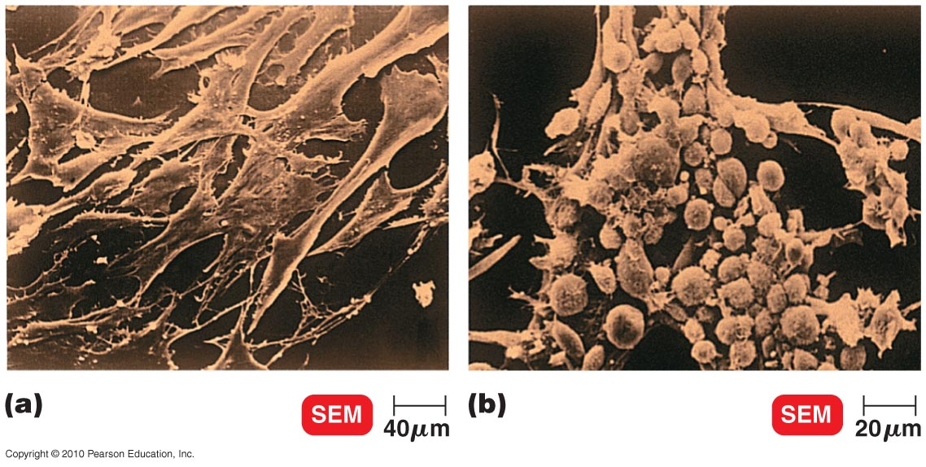
Virus Identification: cytopathic effects
Figure 13.9

Slide 41
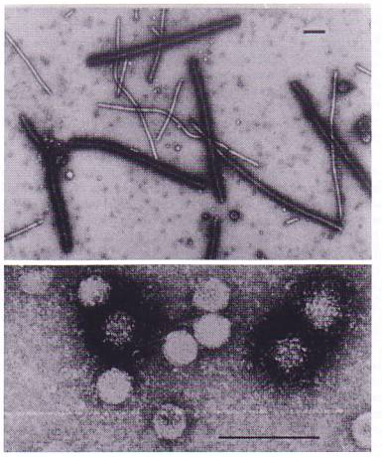
IMMUNOSORBENT ELECTRON MICROSCOPY (ISEM)

Slide 42
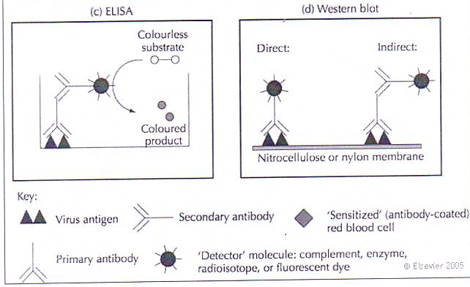
Enzyme-linked immunosorbent assay (ELISA)

Slide 43
Using Staph A protein to detected antibody – antigen complex in a Western blot
decreasing size
virus-infected cell proteins fractionated by PAGE
blot onto nitrocellulose membrane
all proteins stick to blot
incubate with monospecific virus serum
S
labelled Staph A
antibody
viral protein antigen
wash and incubate with labelled Staph A protein
virus protein
host protein

Slide 44
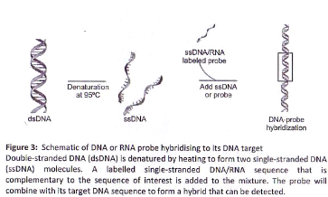
Southern Blot
SB is based on the principal of hybridization of two complementary homologous DNA strands (figure below)
ss DNA test fragments are run on a gel; transferred to a nitrocellulose membrane; and then incubated in a solution containing the probe (known complementary ssDNA sequence) labelled with radioactive or fluorescent nucleotides e.g. Alpha -³²P-dCTP
Unbound nucleotides are washed off and if the two strands hybridize they are detected using an autoradiography film; if no hybridization takes place you know your “test” sample DNA is not related to your known probe

Slide 45
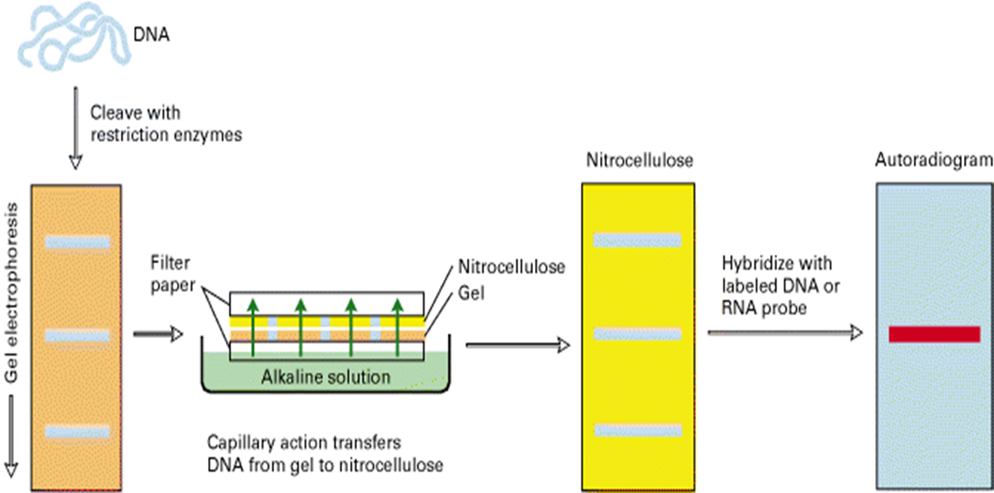
Southern Blot Procedure

Slide 46
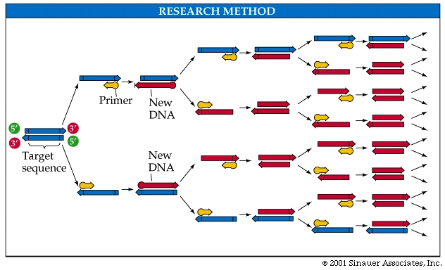
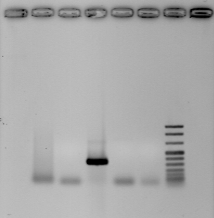
Virus detection/diagnosis
Nucleic acid hybridization: Detection by PCR (Polymerase chain reaction): exponential amplification
Design primer
Steps
Denature DNA 92 ºC
Anneal primer (45 – 60 ºC)
Extension 72ºC
Repeat the 3 cycles ~ 35 times

Slide 47
LIFE CYCLES, REPLICATION AND TRANSCRIPTION OF VIRUSES

Slide 48
Stages in life cycles of animal/human viruses
Attachment: Viruses attach to cell membrane receptors
Penetration by endocytosis or fusion (env); translocation of nucleocapsid (non-env); injection of NA (phages)
Uncoating by viral or host enzymes (or both); pH
Biosynthesis: Production of viral nucleic acid (replication) and mRNA & proteins (transcription and translation)
Assembly & maturation: Nucleic acid and capsid proteins assemble to form complete virion
Release by budding out (exocytosis) (enveloped viruses) or rupture (lysis) by non-enveloped viruses

Slide 49
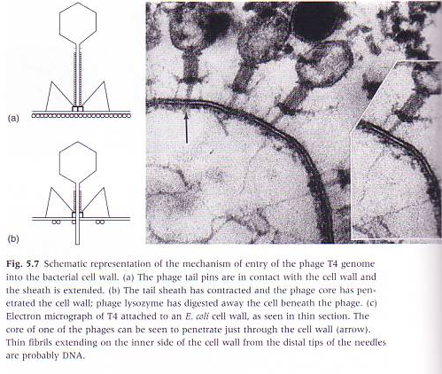
Attachment by injection (bacteria)

Slide 50
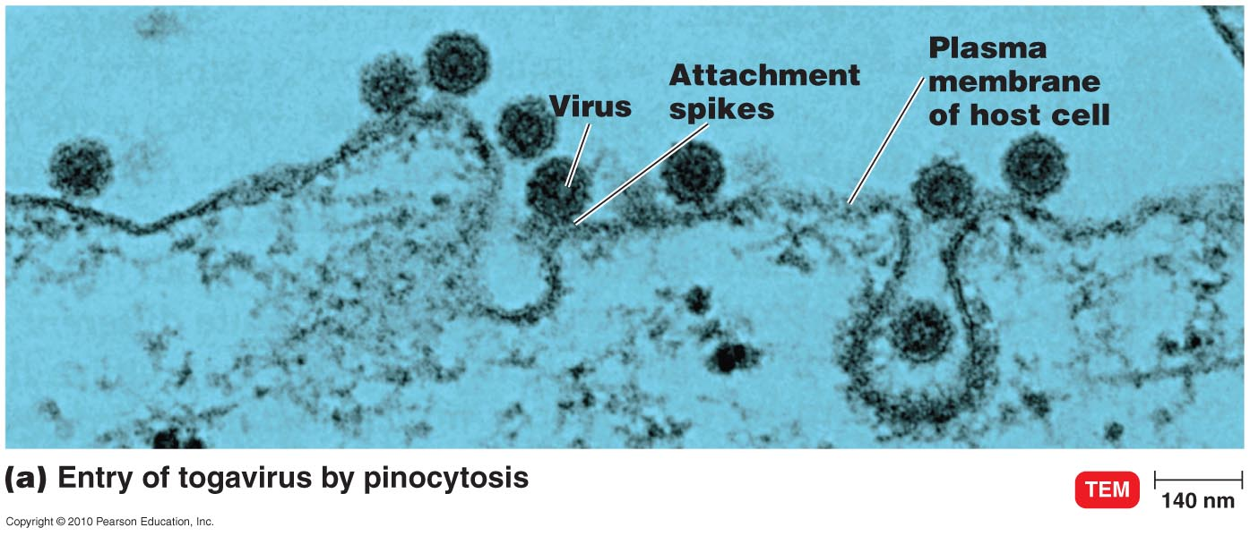
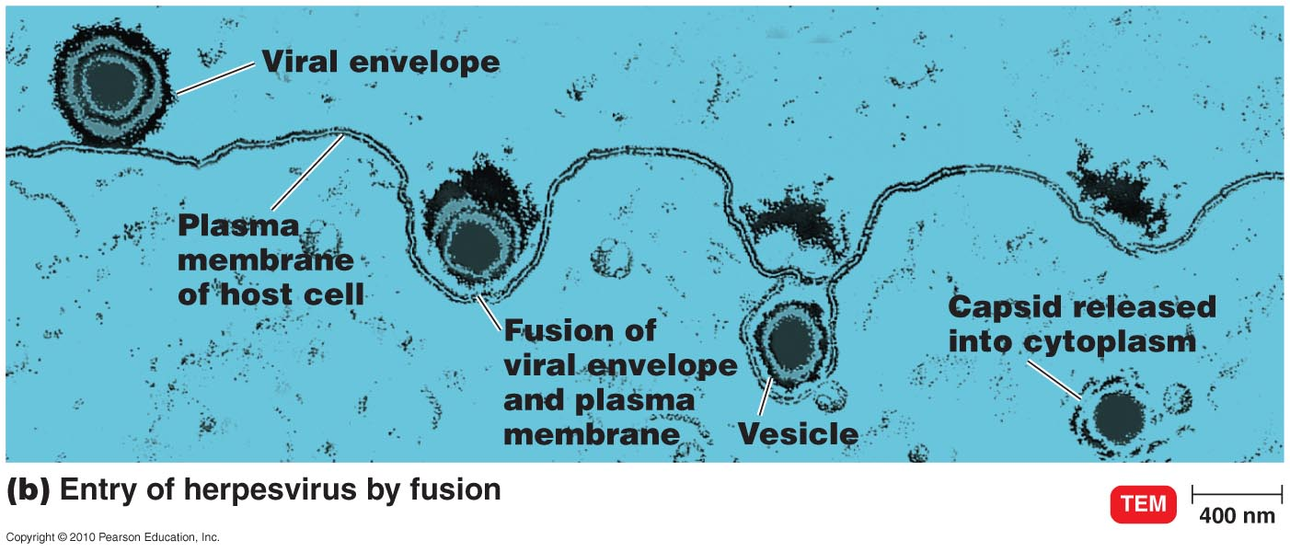
Attachment and Penetration
By pinocytosis/endocytosis
By fusion

Slide 51
Early transcription of viral genome
Protein translation of viral mRNA (by host)
Replication of viral genome
Late transcription & translation

Slide 52
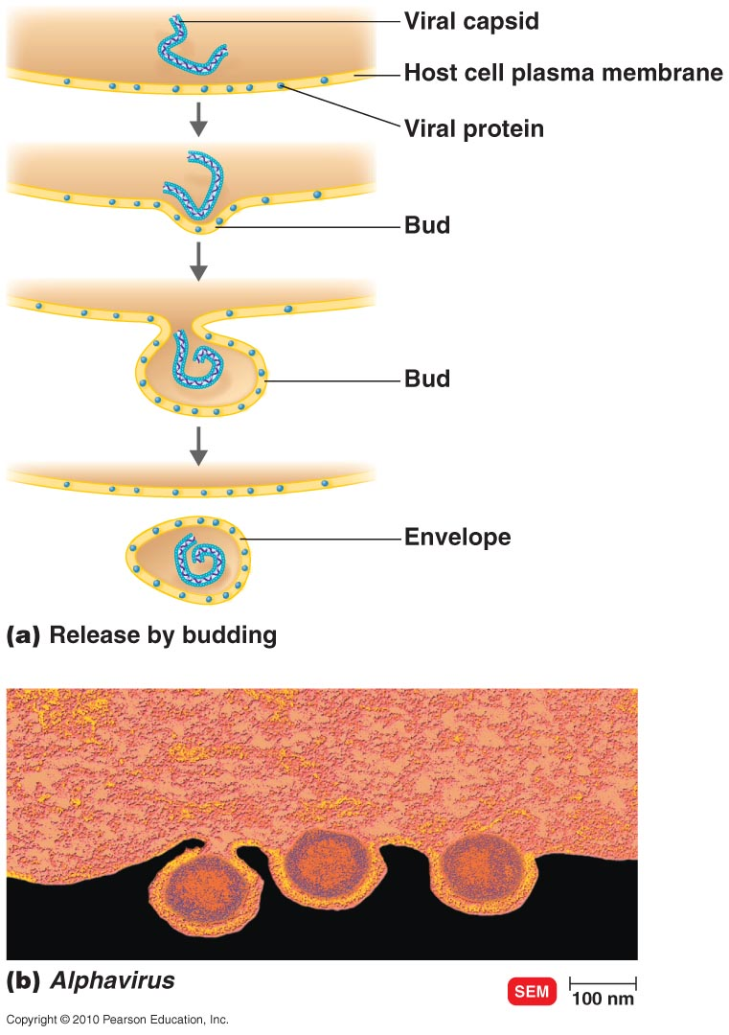
Budding of an Enveloped Virus

Slide 53
Transcription
− DNA
+/- DNA
+ DNA
retroviruses
mRNA
+ RNA
Sub-genomic RNAs (mRNA)
+ RNA
Protein
− RNA
+/- RNA
Direct polyprotein translation and cleavage into smaller polypeptides
Note: mRNA must be capped and polyA-tailed, using mainly host enzymes, before translated by HOST machinery in viruses
All proteins are translated from mRNA by host cellular ribosomal machinery and cellular factors
Notes:
NB Handout pp 61, 62 Basic Virology

Slide 54
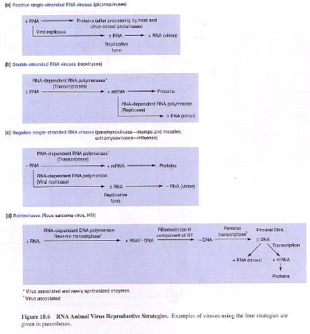
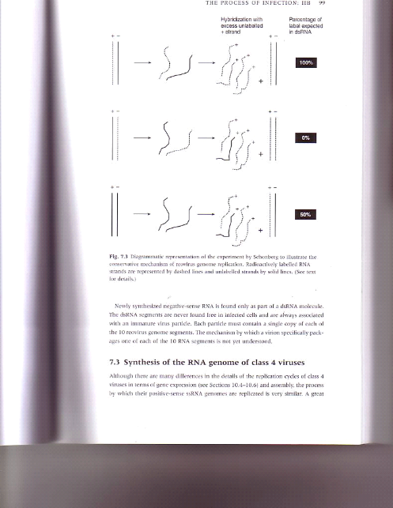
RNA viruses
Replication
DNA viruses:
Replicate (with exception) in the nucleus)
Use host-encoded DNA-dep DNA polymerase (with exception) to replicate
RNA Viruses:
Use RNA- dep RNA polymerase (replicase) to copy RNA (note same RNA pol to transcribe but if transcribe call this transcriptase)
RNA viruses replicate in cytoplasm
ssRNA (-ve or +sense) use a dsRNA intermediate (replicative form) to replicate
dsRNA viruses copy both strands which then pair up
(note that the +ve RNA copied from –ve strand is also used as mRNA)
Retroviruses (ssRNA) use host RNA polymerase to replicate (& transcribe)

Slide 55
Life cycles of a ss DNA and +ssRNA virus

Slide 56
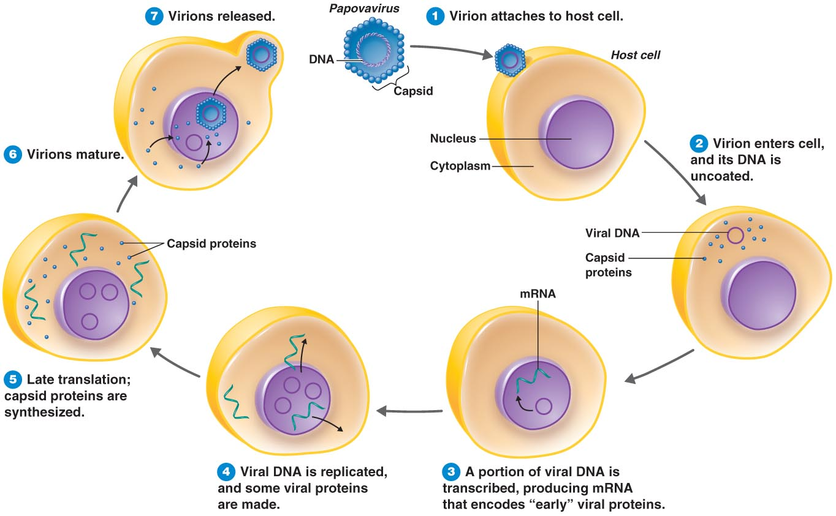
Replication and transcription of DNA Virus
Most DNA viruses replicate in the nucleus
ssDNA viruses (+ or – sense) copy a complementary strand (dsDNA form) which is copied back to original viral genomic strand. The complementary strand of the ds DNA form is the template for mRNA synthesis
dsDNA viruses use either strand to make mRNA and copy both strands in a semi-conservative way like host DNA

Slide 57
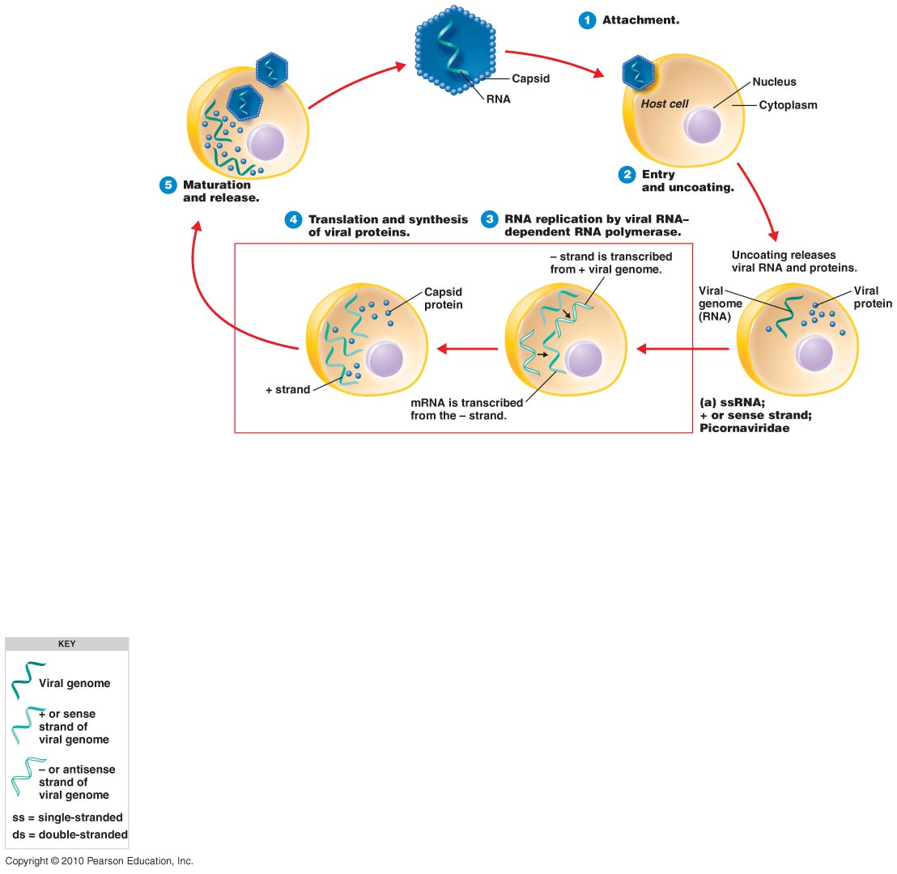
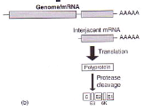

Sense Strand (+ Strand) RNA Virus
By sub-genomic mRNA from
virus genomic + RNA (b) or by polyproteins directly translated from RNA (with Vpg or caps at 5” end and poly A tailed)
** Replication: + sense genomic RNA (called mRNA in +ve sense viruses) synthesised from –ve strand of intermediate replicative form (RF)
Most RNA viruses replicate in cytoplasm
(a)
**
**
+
+

Slide 58

Antisense Strand (– Strand) ss RNA Virus
Note: mRNA (+) synthesized by virus-encoded RNA -dep RNA polymerase present in virus particle; this +sense RNA is template for replication and transcription
Replication uses SAME RNA polymerase: fate of RNA is either genomic (- sense polarity) or mRNA (+ sense polarity)
Replication same as +ve sense via an intermediate replicative form (RF)
(Replication)

Slide 59
Antisense Strand (– Strand) ss RNA Virus
Note: mRNA (+) synthesized by virus-encoded RNA -dep RNA polymerase present in virus particle; this +sense RNA is template for replication and transcription
Replication uses SAME RNA polymerase: fate of RNA is either genomic (- sense polarity) or mRNA (+ sense polarity)
Replication same as +ve sense via an intermediate replicative form (RF)
(Replication)

Slide 60
VIRUSES AND DISEASE
ACUTE, LATENT & PERSISTENT INFECTIONS
EMERGING AND RE-EMERGING VIRUSES
INFLUENZA
HUMAN IMMUNODEFFICIENCY VIRUS (HIV)
Zika virus
Bat viruses

Slide 61
VIRUSES AND INFECTION
Virus infection of a higher organism is the cumulative result of all the processes of replication and gene expression in cells of tissues & immune response or activation (innate and adaptive immunity) by host
Can last for a brief time or may encompass the entire life of the host
Can be regarded as interaction of viruses and intact organisms or viruses and cells
Virus infection induces 3 classes of antibodies (humoral response) i.e. IgG, IgM and IgA whose function is to neutralize the virus and prevent spread. Secretory IgA is important at mucosal surfaces while IgG is most NB for neutralisation of virus particles in the blood.
Cell-mediated immunity is very NB in combating viral infections and is effected through 3 main mechanisms:
- Non-specific killing of infected cells by natural killer (NK) cells
(active in early stages of viral infection & stimulated by interferon)
- Specific killing by cytotoxic T-lymphocytes (CD+8 CTLs)
- Antibody-dependent cellular cytotoxicity (mediated by NK & CTLs but requires Ab bound to virus antigen and IgG bound to CTLby Fc receptor); NK &CTLs can induce apoptosis of infected cells

Slide 62
VIRUS-HOST INTERACTIONS
Site of entry of virus influences course of infection: egs. Skin; mucosal membranes of eye and genito-urinary (e.g. retroviruses; herpesviruses); alimentary canal (e.g. herpesviruses); respiratory tract (e.gs orthomyxoviruses; coronaviruses)
Virus spread in the environment: some viruses are heat; UV -resistant such as water or food-borne viruses but many use a secondary vector for transmission between the primary hosts:
- Horizontal transmission: direct host-to-host
e.g. human-human via aerosol is influenza and relies on high rate of infection.
e.g. animal-human (direct) such as rabies virus; animal-human (by vector such as mosquitoes), for example bunyaviruses
- Vertical transmission: of virus from one generation of hosts to next e.g. mother-child via breastfeeding (e.g. HIV).
Virus initiates infection by entering susceptible cell and can remain localized e.g. in dermis (papillomaviruses) or spread systemically e.g. herpesviruses primary infect genital or urinary tracts and secondary spread/replication in central nervous system and lymphoid cells.
Spread through host is (I) via cell-to-cell or (ii) via direct replication in the blood plasma in association with cells (viraemia) or (iii) nervous system
Spread is controlled by virus’s cell or tissue tropism

Slide 63
VIRUS-HOST INTERACTIONS cont.
The immune response plays a large role in determining on the amount of secondary replication hence spread of virus
IS also plays a large part in determining amount of cell or tissue damage; outcome of any infection is balance between IS clearing virus and putting pressure on virus to alter its antigenic composition e.g. influenza
Viruses may replicate widely without significant cell death or damage e.g. retroviruses. Conversely picornaviruses for e.g lyse cells leading to fever and with poliovirus CNS damage and respiratory failure
Another factor that determines outcome of virus infection is ability of virus to persist in the host (immunosuppression; downregulation of MHC1 proteins etc.)
There are different types or patterns of virus infections:
Abortive: virus infects cell but cannot complete full replication cycle
Acute: virus replicates before symptoms; rapid onset; IS clears infection quickly
Chronic: Ongoing virus replication but virus adjusts pathogenicity to avoid killing host; virus eventually cleared by the host (exceptions Hepatitis B; 10% carriers)
Persistent: Same as chronic but virus persist in host for its entire lifetime. Not infrequently persistent infections may result from DIs that modify pathogenesis
Latent: Persist but virus able to downregulate its gene expression & establish an inactive state e.g. HSV travels via axons & hides in dorsal root ganglia of NS

Slide 64
Emerging and re-emerging diseases

Slide 65

Acute, Latent and Persistent Viral Infections
Acute: Virus multiplies rapidly; acute symptoms for short time; virus cleared from body by immune system
Latent: Virus remains in asymptomatic host cell for long periods; IS does not clear
  Cold sores, shingles
Persistent: Disease processes occurs over a long period (generally lifetime of host); IS does not clear;
- can be
fatal e.g. HIV

Slide 66

Orthomyxoviridae
Single-stranded RNA, –ve sense strand, multiple RNA strands
Envelope spikes can agglutinate RBCs
Influenza virus (influenza viruses A and B have 8 segments)
  Influenza C virus (7 segments
Schematic diagram of Influenza A virion structure
M2
Nucleoprotein-RNA complex
M1 matrix protein
hemagglutinin
neuraminidase
Lipid bilayer
  All RNA segments replicate separately and are required for a productive infection

Slide 67
Influenza Epidemics
flu considered to be a mild disease
Major killer of the aged and immune compromised
able to build up effective immune response
periodic outbreaks where prior protection ineffective
due to virus broad host range; natural reservoir of influenza A is wild birds
genome segment re-assortment where viral mutations able to effectively disseminate
antigenic drift: gradual accumulation of mutations in genome (neutralizing Ab pressure), affecting surface proteins (antigenicity) & leading to decrease in recognition by IS; occurs in all viruses but at different rates. IS in response adapts .
Genome segment re-assortment between diff antigenic types can lead to sudden dramatic changes in the antigenic properties – antigenic shift (problem exacerbated by sharing hosts e.g. pig virus – human virus sharing a cell) leading to worldwide epidemics (pandemics); have been 4 major shifts; shift accompanied by abrupt change in HA and NA subtype
Reassortment between pig and avian varieties often cause of antigenic shift leading to new outbreak strains

Slide 68



Slide 69
Influenza epidemics
ribonucleoprotein
Shift in HA
Antigenic change
Major shift in surface antigens
NA
HA
1889 1918 1957 1968
avian flu
swine flu

Slide 70

INFLUENZA & ANTIGENIC SHIFTAND DRIFT

Slide 71

HUMAN IMMUNODEFFICIENCY VIRUS (HIV)
Lentivirus; highly pathogenic
HIV-1 is a collection of evolutionary linked clades based on nt sequence of gag or env genes.
9719 nt long; 16 proteins
Are diploid (two identical ssRNA molecules); 3 ORFs: gag, pol and env which are transcribed and translated into polyproteins which are cleaved by proteases; regulatory proteins expressed from spliced RNAs
ssRNA is reverse transcribed into dsDNA which integrates into host genome
Require cellular tRNA for replication primer; ss viral RNA genome transcribed/replicated by host RNA pol II from provirus (integrated dsDNA)
The provirus is under host cell control and is transcribed as are other cellular genes. Cellular transcription factors bind to promoter sites in LTRs and promote virus gene transcription.
HIV can however positively or negatively regulate expression of their genetic information using Tat, Rev, Vif, Vpr, Vpu & Nef proteins; e.g. Tat proteins stimulate virus gene transcription and Rev proteins regulates balance of expression between virion structural proteins and regulatory proteins

Slide 72

Life cycle of a Retrovirus e.g. HIV

Slide 73
The viral DNA that is integrated into the host genome is called a provirus
Unlike a prophage, a provirus remains a permanent resident of the host cell
The host RNA polymerase transcribes the proviral DNA into mRNA molecules for synthesis of viral proteins and full length RNA molecules (genomes) for new virus particles released from the cell
© 2011 Pearson Education, Inc.

Slide 74

Global distribution of HIV-1 subtypes and recombinants

Slide 75


Slide 76
HIV PREVENTION & TREATMENT
PREVENTION
Sexual behaviour: condoms; testing; no. of partners; education
TREATMENT
Antiretroviral drugs (HAART)
Nucleotide Reverse transcriptase inhibitors
Non-nucleotide RT inhibitors
Protease inhibitors
New strategies
Integrase inhibitors
Receptor blocking
Vaccines
Prevention better than cure!

Slide 77


Slide 78


HIV VACCINE UPDATE
Dr Penny Moore
What is a vaccine?
• A vaccine is a substance that stimulates an immune response that can either prevent an infection or create a resistance to an infection.
• No vaccine is 100% effective - Most are between 70% and 95% effective
• Vaccines provide both an individual benefit and a public health benefit

Slide 79
Why is it so difficult to make an HIV vaccine?
Nobody has ever recovered from HIV infection, so there is not natural mechanism to imitate
HIV destroys the immune system cells that are meant to fight against it
HIV inserts its genetic material into human cells, where it remains hidden
HIV RNA mutates: proteins are highly variable and constantly changing to avoid IS
There are no good animal models to test vaccines
Antibody neutralization-sensitive sites on HIV are masked

Slide 80

Facts about Zika virus
The Zika virus is carried by infected mosquitos of the Aedes genus and spreads aggressively
Following the first report in Brazil in May 2015, the virus has now spread to at least 25 countries.
While symptoms for the virus are relatively mild, the risk to unborn children is more severe, and can lead to significant birth defects.
Interestingly, the virus had gone years without an outbreak of this proportion, so why the sudden change? A recent report, currently under peer review, suggests that mutations to the viral genome may have contributed to its ability to infect cells so easily.
Specifically, NS1 codon usage adaptation (in neural cells) may have enabled viral replication
The Zika virus belongs to the family Flaviviridae family and the genus Flavivirus, thus is related to the dengue, yellow fever, Japanese encephalitis, and West Nile viruses.
Like other flaviviruses, Zika virus is enveloped and icosahedral and has a nonsegmented, single-stranded, 10-kilobase, positive-sense RNA genome.

Slide 81

Zika virus infection of neural progenitor cells
Zika virus (ZIKV) infects human embryonic cortical neural
progenitor cells (hNPCs)
ZIKV-infected hNPCs produce infectious ZIKV particles
ZIKV infection leads to increased cell death of hNPCs
ZIKV infection dysregulates cell cycle and transcription in
hNPCs

Slide 82



